Slide 1
Building a Successful UnFranchise/Wellness Business with Health & Nutrition and Age Management

Slide 2
Five steps to building a successful UnFranchise Business
Apply
Application Fee
Create BV
Wellness 101/Product Overview (Do this first and cover cost)
10 customers > 30 BV
Qualify
Fast Start Kit = 300 BV
Activate
Many customers become Business Partners
DUPLICATE

Slide 3
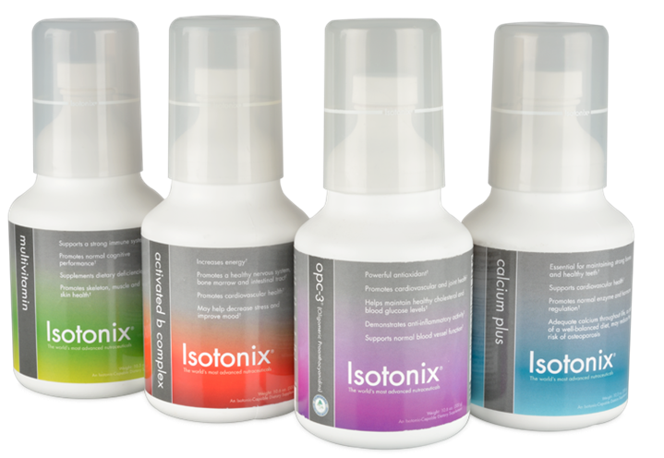
Product Profit Analysis
Isotonix Daily Essentials Kit
Dist. Cost | Sugg. Retail | B.V. | Gross Profit | % Profit
$100.00 | $139.95 | 65 | $39.95 | 39%
Save over $50 when you purchase the Isotonix Daily Essentials Kit!
$195 Value!
Notes:
At your Wellness Presentation many kits were sold! You can see the Savings listed here as well as the Profit for each Kit.
Of course there is additional Savings and Profit for you as a Distributor of $40
So you can see that you will earn $40 on each Kit that you sell to a customer.

Slide 4
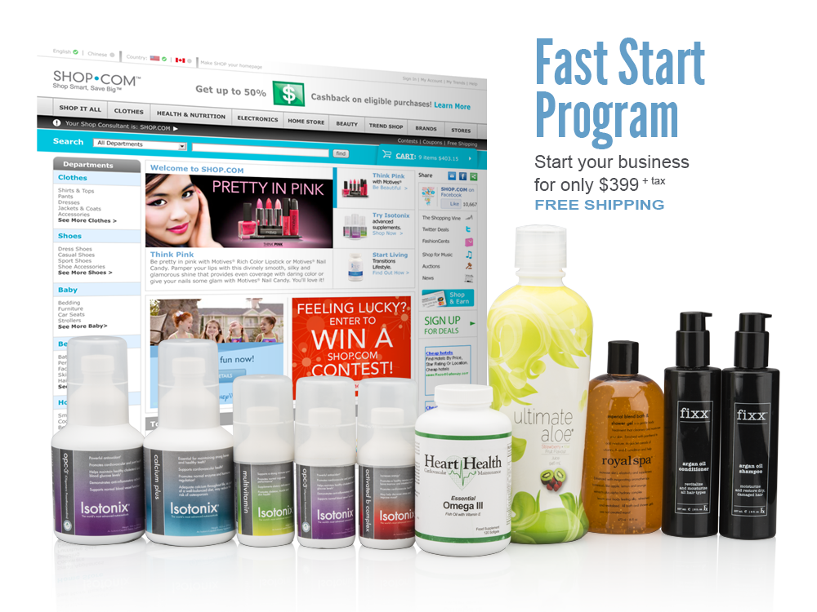
Also available:
Notes:
When you apply you have the opportunity to take advantage of our Fast Start Kit and Program
For just uner $400 you can order your Products to begin your Wellness Business
That’s an additional savings of $200 under Dist. Cost.

Slide 5
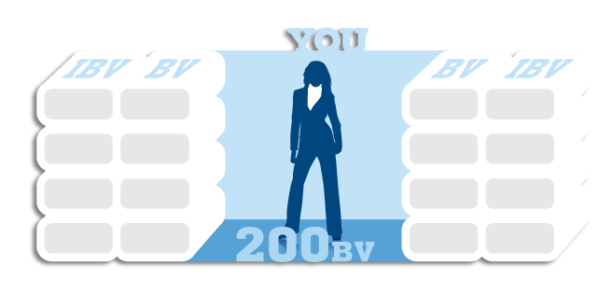
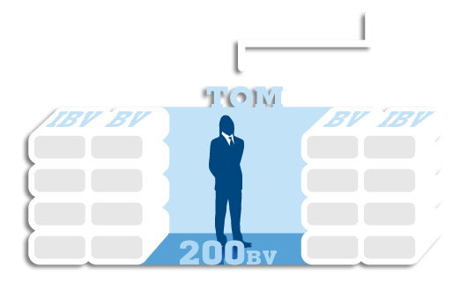
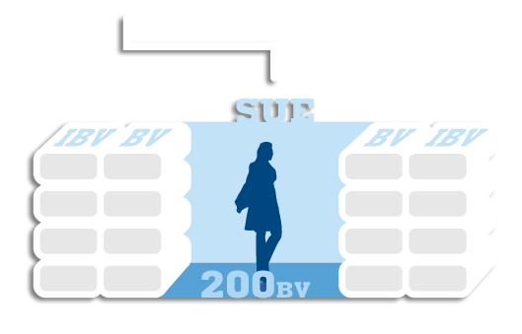
Activate
Personally sponsor and place one qualified Independent Distributor in your left organization and one qualified Independent Distributor in your right organization
Notes:
5
This slide indicates that you can Leverage your time by Helping 2 other people start their Wellness Business with you. This is Called ACTIVATION>
Once activated you become eligible to earn commissions and bonuses based on the accrued BV & IBV from your left and right organizations
Q: Why just two sales and distribution organizations?
A: The number 2 is the smallest multiplier for the highest profit. Statistics show that the average person successfully develops 2.8 organizations
Talking Points
Personally sponsor and place one qualified Independent Distributor in your left organization and one qualified Independent Distributor in your right organization
Objective: To develop these Independent Distributors into successful UnFranchise® Owners managing an organization of Customer Managers and Independent Distributors
Can you think of anyone interested in operating his/her own home-based business that could generate an income of $300 to $3,600 per week or more?
Can you think of someone interested in choosing a 2– to 3–Year plan for his/her own success rather than the 45-year plan, working for someone else’s success?
Once activated, you become eligible to earn commissions and bonuses based on the accrued Business Volume from your left and right organizations
MPCP- the least amount of production yields the highest return
Why two?
- The number two (2) is the smallest multiplier for the highest profit
- In line with what the average person has been proven to do

Slide 6
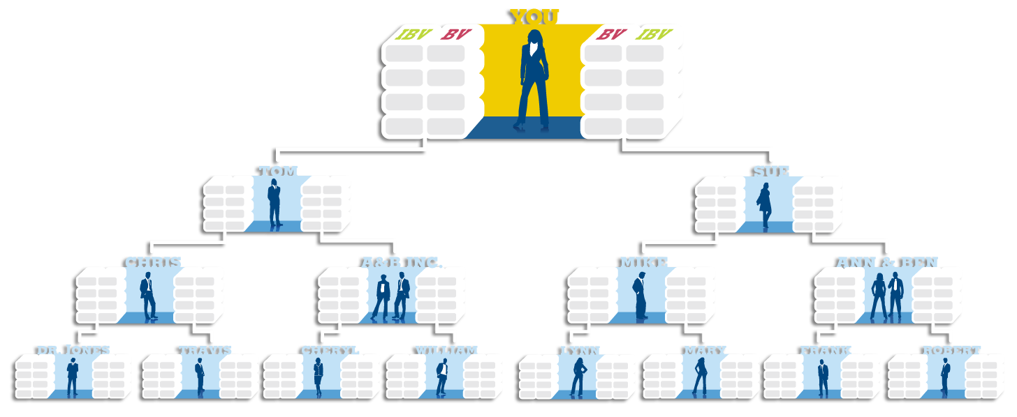
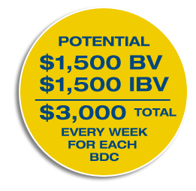
How Commissions Are Earned
System Search
5,000
5,000
System Search
3,600
3,600
2,400
2,400
1,200
1,200
1,200 total BV from your left and right = $300 | 1,200 total IBV from your left and right = $300
2,400 total BV from your left and right = $300 | 2,400 total IBV from your left and right = $300
3,600 total BV from your left and right = $300 | 3,600 total IBV from your left and right = $300
5,000 total BV from your left and right = $600 | 5,000 total IBV from your left and right = $600
Notes:
6
Take a Close look: This is How we earn Commisions: (This may take more than one time to trully comprehend and even look like it is too good to be true.) That’s what I thought the first time I saw this!
No breakaways or limits in depth of search for purposes of accruing BV! BUILD TO INFINITY!
When you accrue at least 1,200 BV in your left and right organizations, you will have earned a $300 commission (Coordinator)
If you fall short of the required 1,200 BV on either or both sides, you do not lose the volume for that week. It is carried over to the following week, and the following week’s BV totals are added to it until you meet the 1,200 BV criteria (it is not a question of IF you will earn, it is a question of WHEN)
Volume accumulates up to one year when exercising the monthly accrual option
When you accrue at least 1,200 BV more in your left and right organizations, equaling a total of at least 2400 BV accrued on each side, you will have earned another $300
When you accrue at least 1,200 BV more in your left and right organizations, equaling a total of at least 3,600 BV accrued on each side, you will have earned another $300
When you accrue at least 1,400 BV more in your left and right organizations, equaling a total of at least 5,000 BV accrued on each side you will have earned another commission for $600 (Executive Coordinator)
Total commissions: $1,500
Your BDCs accrued volume totals are reset to zero, and begin accruing new BV toward 1,200, 2,400, 3,600, and 5,000 compensation criteria all over again
Now, you have an organisation of UnFranchise® Owners and Independent Distributors with customers in place, re-ordering products and regenerating BV
As time goes on, it becomes easier to earn weekly checks
Existing Independent Distributors are adding new people and producing more repeat sales
Becomes easier to reach 5,000/5,000
Until earning $1,500 every week
Based on your accrued BV totals for a given week, you will earn anywhere form $300 to $1,500 per week

Slide 7
What does this translate to?
DESCRIPTION
GRP BV
Total BV COMMISSION
18.5 (Daily Essentials)
18.5 (Daily Essentials)
$ 739.08 65 each = 1200
>
300
$ 739.08 65 each = 1200
77 (Daily Essentials)
77 (Daily Essentials)
$2,996.25 65 each = 5000
>
1500
$2,996.25 65 each = 5000
Notes:
TO KEEP THIS SIMPLE AND EQUATE THE PLAN TO THE DAILY ESSENTIALS KIT HERE IS WHAT
ALL OF THIS TRANSLATES TO!
WHEN YOU ARE LEVERAGING YOUR TIME AND DUPLICATING THIS IN YOUR LEFT AND RIGHT TEAMS YOU WILL GROW A WELLNESS BUSINESS VERY QUICKLY!

Slide 8
FOLLOW UP
MEETING AFTER THE MEETING!

Slide 9
Retailing Goal – Base 10, Seven Strong
After Three to Six Months, Earn >$300 Monthly
1200 BV
1200 BV
400 BV
400 BV
400 BV
400 BV
400 BV
400 BV
400 BV

Slide 10
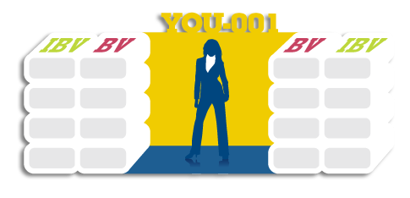
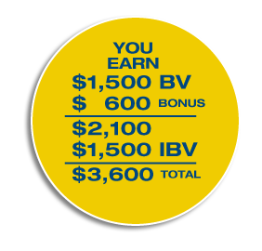
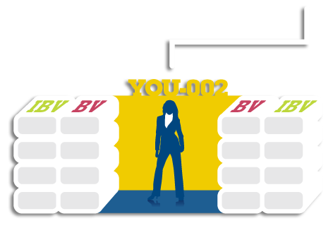
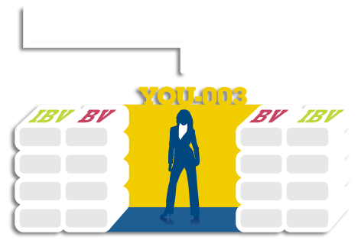
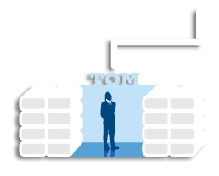
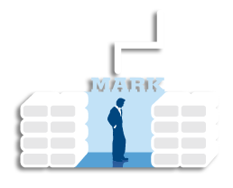
Master UnFranchise Owner
Enables you to leverage your efforts by opening multiple BDCs from the beginning
Put in twice the work for three times the pay!
Annual earnings potential: $561,600
Notes:
10
Talking Points
For those who are willing to make a greater commitment to their business
Must be established when you initially open your UnFranchise® Business
Rather than wait until later to open additional BDCs, you may establish three BDCs initially
Leverage your time and efforts
Must accumulate and sell 600 BV to fully qualify
Initially develop two sales organizations
Begin earning commissions from your 001 BDC
Your 001 is the only BDC with ongoing requirements

Slide 11
The Value of One Customer a Week
If just one new customer a week purchases 30-day supplies of both Isotonix Multivitamin and Heart Health Essential Omega III Fish Oil with Vitamin E, you could earn $64 a month in retail profit.
If each of those customers continues to purchase each month, in addition to continuing to introduce new customers to Isotonix Multivitamin and Heart Health Essential Omega III Fish Oil with Vitamin E, your gross retail profit would increase to $4,992 a year.*
*Assumes 100% re-order rate

